Slide 1
Minimizing Load Defaults at Credit One
Over the last 12 months more and more of our customers lendees have been defaulting on loans
Customers have started to ask questions about our methodology
The current scoring system we’re utilizing for our customers is inadequate
How do we modernize our scoring methods so we can show customers empirically that’s we’re making calls based off the correct factors

Slide 2
Project Goals
Discover insights within our database that helps us minimize our defaults and get the business back on stable footing when it comes to choose the right groups of customers to lend to?
Looking key factors (if they exist) that point to customers’ likelihood of default
Finding out who are lendees are at the Marco level
Creating a clear, concise data set which gives us the most accurate findings

Slide 3
The Data
We’re going to be leveraging a 3000 + customer information database to make conclusions about our methodology
This database is located on an offsite cloud-based platform
The data is in a very raw state and will need to be cleaned up pre-use
There appears to be some copy-paste errors in the data- this will need validation before we can draw any conclusions from it

Slide 4
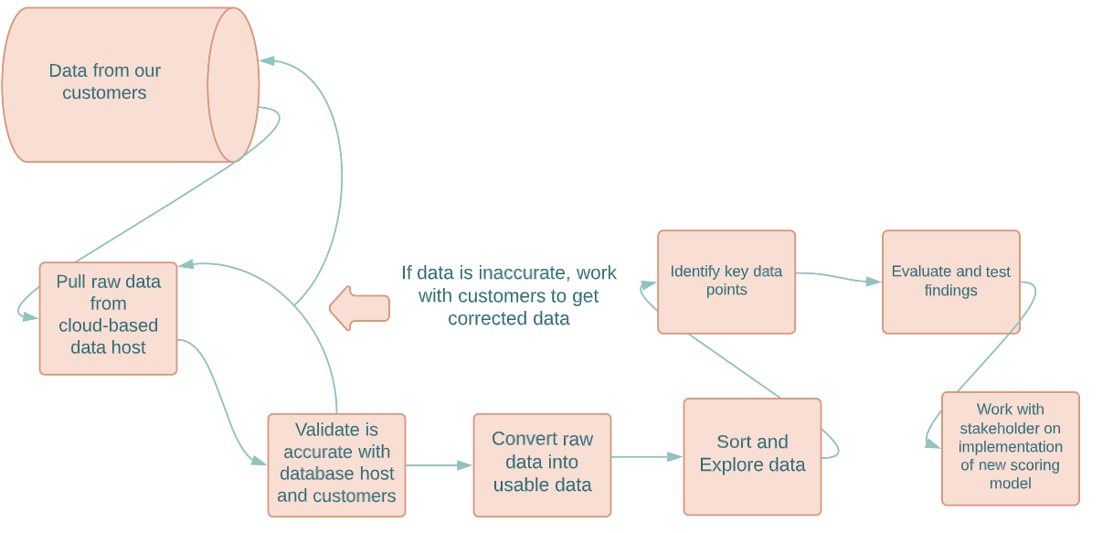
Plan of Attack

Slide 5
Next Steps
Schedule Meeting with stakeholders to align on business needs
Share preliminary data findings
Align on resources need for the project

